Slide 1


Win32apps - Understanding retry behaviors
Liviu Barbat
Twitter - @LeeViewB
LinkedIn

Slide 2

Win32apps - Understanding retry behaviors
If you’re managing Windows Devices using Intune, it’s very likely that you deployed win32apps to install software on them.
In some cases, due to various reasons, the install will fail.
If it does, how will Intune react? When is it going to retry the install?
Let’s find out.

Slide 3
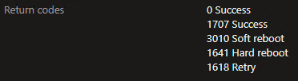
Win32apps - Understanding retry behaviors
Win32app Default Return Codes
0 = success
1618 known failure exit code
1603 unknown failure exit code

Slide 4
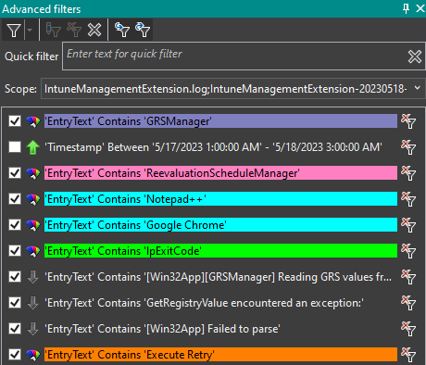
Win32apps - Understanding retry behaviors
Off-Topic:
I am using OneTrace and the Advanced Filters option to better parse logs. I blogged about the usefulness of this tool here.

Slide 5
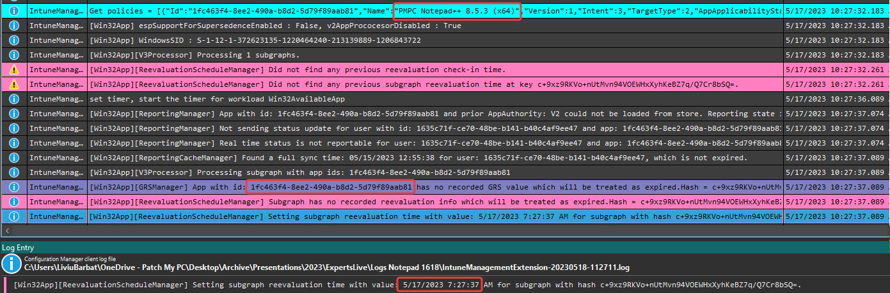
Win32apps - Understanding retry behaviors
When a new app is assigned, it is evaluated as a first step
Time Column is local | Time in the low row is UTC
Two components manage deployments:
GRS (Global Retry Schedule) and Reevaluation Schedule Manager

Slide 6
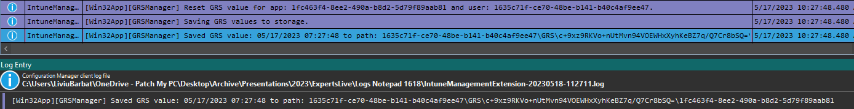
Win32apps - Understanding retry behaviors
The GRS Value will be set, so Intune will know when to retry the install should it fail

Slide 7
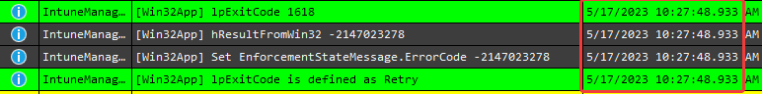
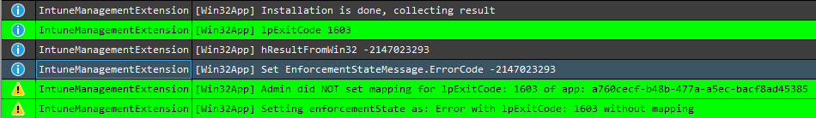
Win32apps - Understanding retry behaviors
Exit code battle commence
The content will be downloaded, the install will take place. The Exit Code will be evaluated.

Slide 8
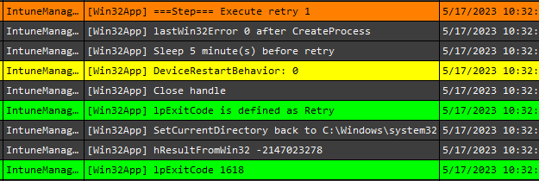
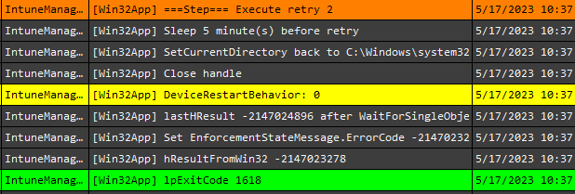
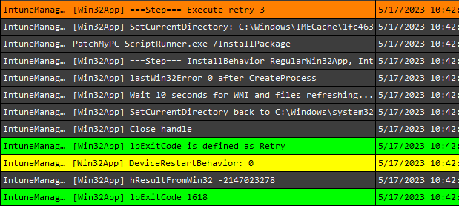
Win32apps - Understanding retry behaviors
Exit code 1618 (or any Return Code marked as Retry)

Slide 9
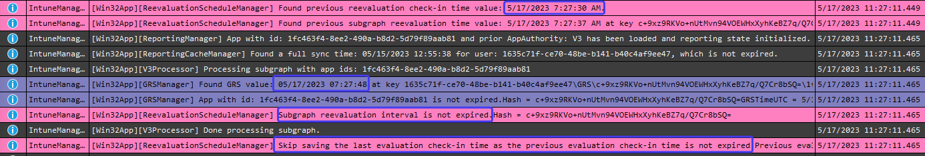
Win32apps - Understanding retry behaviors
After the 3 retries, the retry will be handled just as a regular failure (1603 in our case)
IME will evaluate the app every hour when the sync runs.
If 8 hours did not pass since the failure occurred, the app will be skipped during evaluation

Slide 10
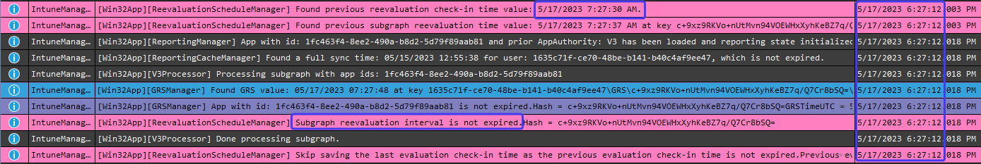
Win32apps - Understanding retry behaviors
This behaviour will repeat for 8 hours. After 8 hours:
The subgraph reevaluation interval is still not expired??
The app was evaluated a few seconds too soon!
We need to wait another hour

Slide 11
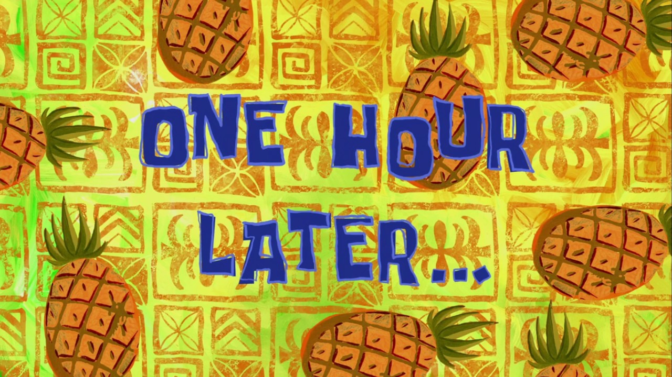
Win32apps - Understanding retry behaviors

Slide 12
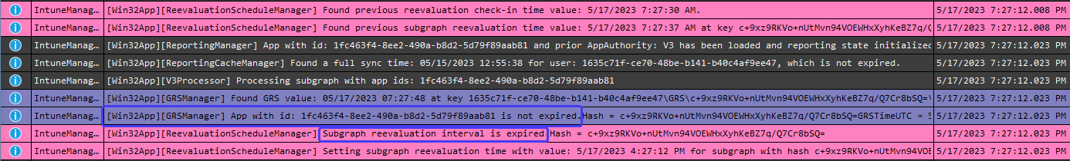
Win32apps - Understanding retry behaviors
1 hour later:
The subgraph reevaluation interval is finally expired
The GRS interval is not expired, therefore, the install will not be retried.
It will expire only 24 hours later after the saved GRS time.

Slide 13
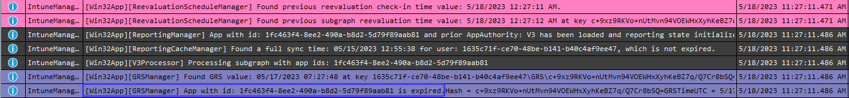
Win32apps - Understanding retry behaviors
24 hours later from the initial evaluation:
The subgraph reevaluation interval is finally expired.
The install will be attempted again.

Slide 14
Win32apps - Understanding retry behaviors
Exit Code marked as Retry
Install will be attempted
If failed, retry 3 times every 5 minutes
If failed, add the app to GRS
24 hours later, try to install again.
If failed, retry 3 times every 5 minutes.
Exit Code marked as Failed or not specified at all
Install will be attempted
If failed, add the app to GRS
24 hours later, try to install again.
If failed, add the app to GRS

Slide 15
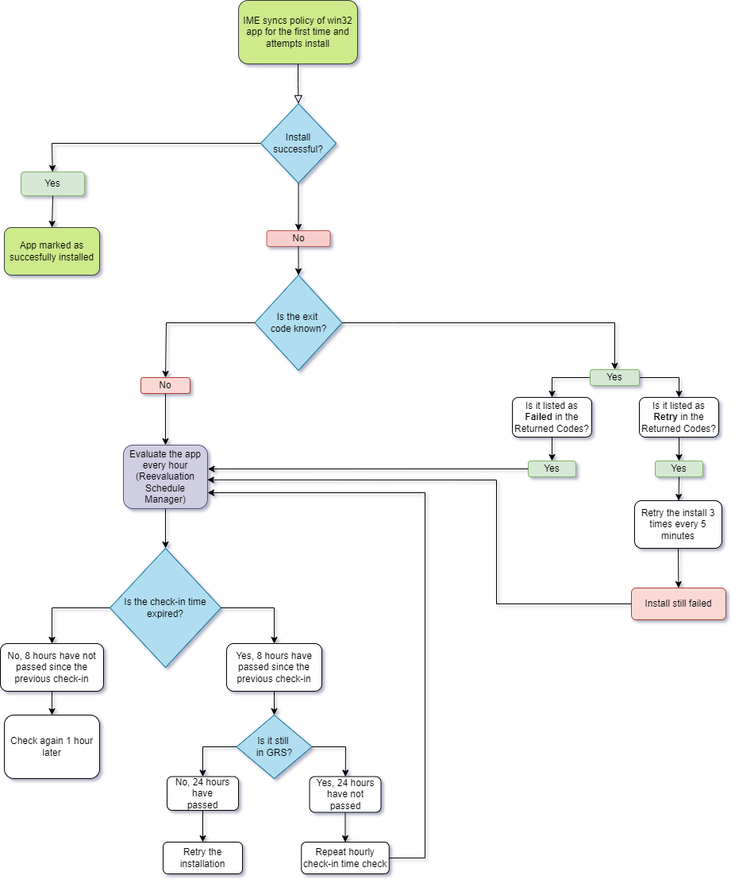

Win32apps - Understanding retry behaviors

Slide 16
Live Demo!

